Slide 1
INSTRUCTIONS
Use Font size 22 to 28 and Font Style Times New Roman (body)
Do not change the Template: Heading / Title of the slides
Do not change font style or colours
Do not copy paste paragraphs: use only Bullet Points
Maximum slide Limit is 20 only
As per the number of supervisor allotted adopt slide-2 or slide-3
Please display the required meaningful Content or images or tables
Change the footer accordingly using insert tab then click on header & footer tab and edit it
Save the PPT with Register No, Dept and Review no, example: 23xxxxxxxxx_CSE

Slide 2

Title: THE THOUGHTFUL WRITING SPACE
Student Name: D.MANYA AKSHITHA
Student ID: 2520090032
Cluster:3
Section: 11
Under the Guidance
of
Supervisor Name: T.S.P MADHURI
Assistant Professor
Department of CSE

Slide 3
OUTLINE
Abstract
Existing System
Proposed System
System Architecture
Project Modules
Objectives
Co’s Attainments - FWD
Co1
Co2 …….. 5. Co5
Co’s Attainments - DSA
Co1
Co2 …….. 5. Co5
Screen Shots for FWD & DSA
Conclusion
Geo-Tagged Photos

Slide 4
Abstract
The journal web page is designed to provide a digital platform where users can write and store their daily thoughts and reflections.
The system allows users to register and create a personal space for recording their experiences and emotions.
After registration, users can write about their daily reflection and important events that happened during the day.
The application then guides the user to the next page where they can describe how they feel, what they have learned, what changes they want to make in themselves, and how they want to improve.
The platform encourages users to practice regular writing which helps in self-analysis, emotional expression, and personal development.
The project provides a simple and organized environment for thoughtful writing and maintaining personal growth records.

Slide 5
Existing System
Limitations of Existing Systems
Even though these systems are powerful, they have some limitations:
Many apps require paid subscriptions
Limited customization for academic projects
Most do not show algorithmic learning or DSA concepts
Some apps store data in the cloud, raising privacy concerns

Slide 6
Proposed System
Providing structured self-reflection questions.
Allowing users to observe personal change over time.
Tracks personal Growth Over Time.

Slide 7
System Architecture
1. Presentation Layer (User Interface)
This is the front-end part where users interact with the system.
2. Application Layer (Logic Layer)
This layer contains the processing logic of the system
3. Data Layer (Storage Layer)
This layer stores all system data.

Slide 8
Project Modules
Module 1: User Registration Module
Allows new users to create an account.
Collects user details such as name, email, and password.
Module 2: Login Module
Authenticates registered users.
Allows secure access to the journaling system.
Module 3: Daily Reflection Module
Users write about how their day went.
Helps user's express thoughts and experiences.
Module 4: Self-Reflection Module
Users answer guided questions:
How do you feel today?
What did you learn today?
What changes do you want to make?
How do you want to improve yourself?
Module 5: Journal Storage Module
Stores user reflections.
Maintains a history of journal entries.

Slide 9
Objectives
To provide a digital journaling platform where users can register and record their daily reflections and thoughts easily.
To encourage self-reflection and personal growth by allowing users to write about their feelings, lessons learned, and improvements they want to make in themselves.
To organize journal entries efficiently using Data Structures concepts such as lists, stacks, and queues for storing and managing user data.
To enable efficient searching and sorting of journal entries using algorithms like Linear Search, Binary Search, and Sorting techniques.
To provide a structured writing flow where users first reflect on their day and then move to another page to describe emotions, learning experiences, and personal development goals.
To build an interactive and user-friendly journaling system

Slide 10
Co’s Attainments - FWD
CO1
Understand Internet fundamentals, HTTP/HTTPS protocols, and web client-server architecture.
Explain browser functionality, developer tools, web hosting, and domain concepts.
Apply HTML document structure and basic webpage elements such as lists, links, and images.
CO2
Design structured web pages using HTML forms, semantic tags, tables, and media elements.
Apply CSS styling techniques including selectors, typography, colors, and spacing.
Implement modern layout techniques using Flexbox, CSS Grid, and responsive design.
CO3
Apply JavaScript fundamentals including variables, operators, conditions, loops, and functions.
Work with arrays, objects, and ES6 features for efficient programming.
Implement functional programming concepts such as arrow functions and callbacks.
CO4
Perform DOM manipulation and event handling to create dynamic web pages.
Use browser storage such as localStorage and sessionStorage for client-side data.
Implement asynchronous programming using Promises, fetch(), async, and await.
CO5
Implement form validation and API integration using JavaScript.
Apply performance optimization techniques and SEO practices for web applications.
Deploy responsive and interactive web applications with improved usability.

Slide 11
Co’s Attainments - DSA
CO1
Analyze problem statements using asymptotic notation (Big-O, Ω, Θ).
Compare algorithm efficiency based on time and space complexity.
Implement and evaluate searching and sorting algorithms in Java.
CO2
Design and implement Abstract Data Types (ADTs) using arrays and linked lists.
Perform operations such as insertion, deletion, searching, and traversal.
Evaluate advantages and limitations of different data structures.
CO3
Apply stacks and queues to solve real-world workflow problems.
Implement circular queues, deques, heaps, and priority queues.
Analyze performance compared to other linear data structures.
CO4
Design hash-based data structures using hashing techniques.
Implement hash tables with chaining and open addressing.
Utilize Java Collections (List, Queue, Deque, Map) for efficient solutions.
CO5
Develop practical applications using linear data structures.
Implement data structures to solve real-world computational problems.

Slide 12
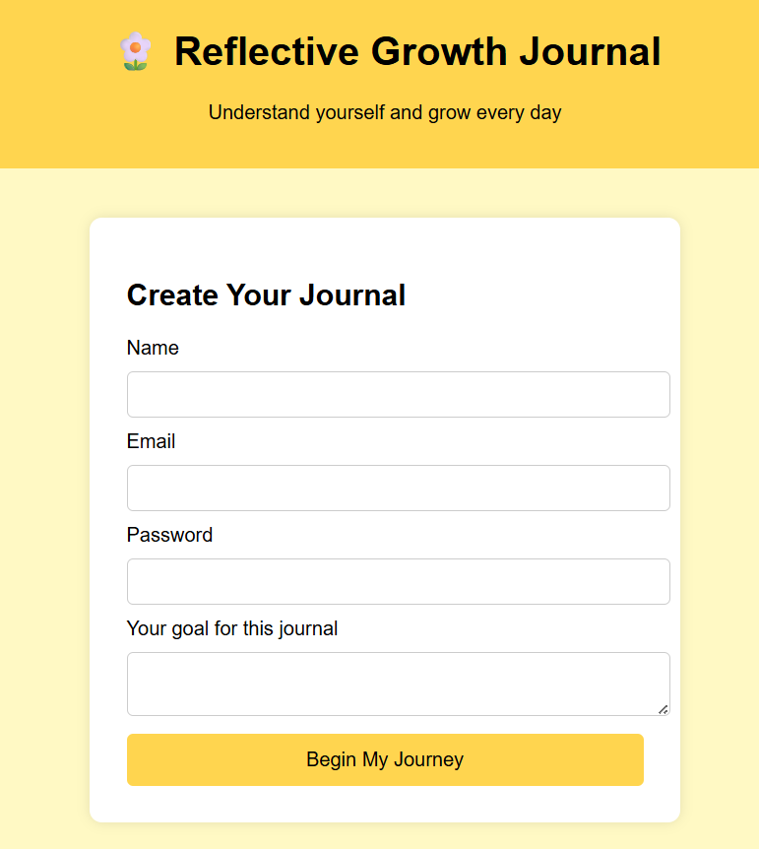
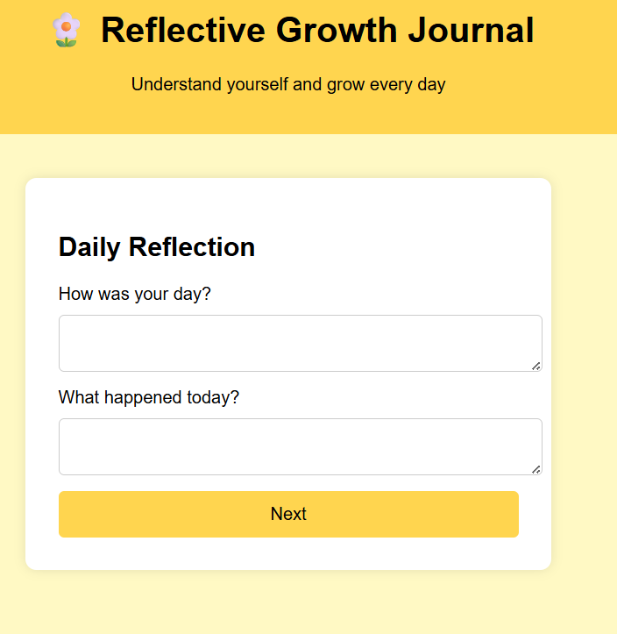
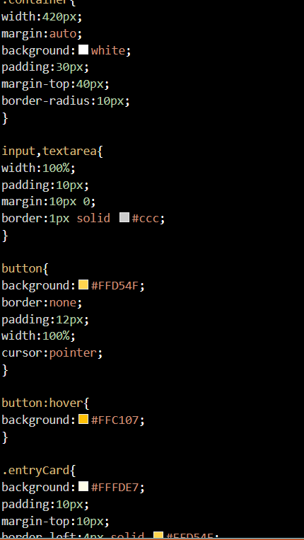
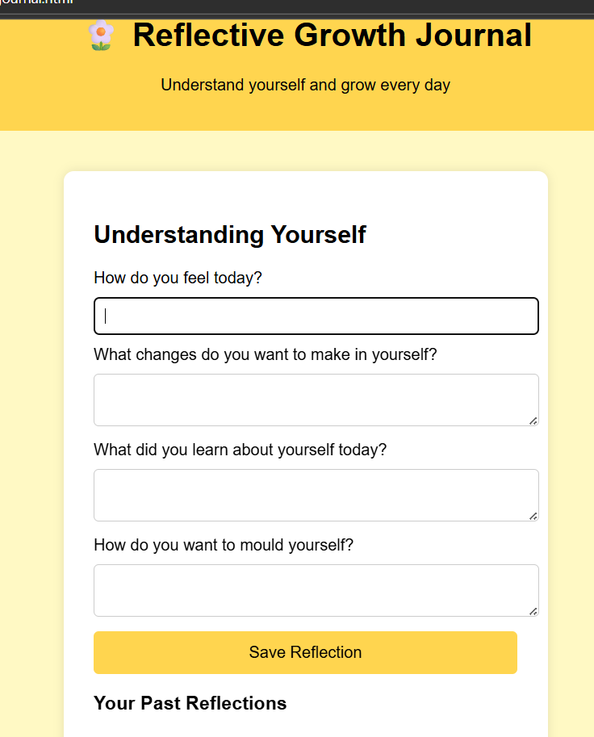
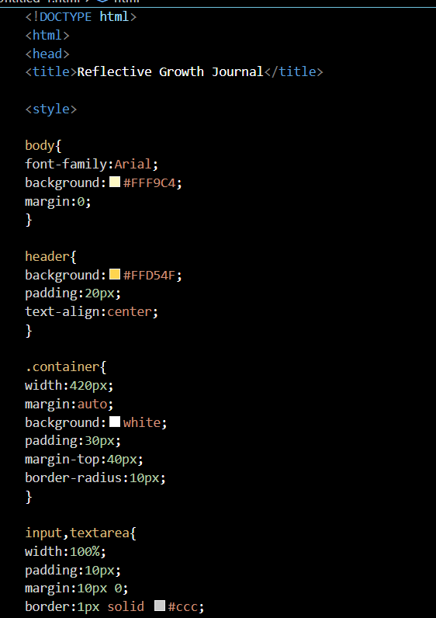
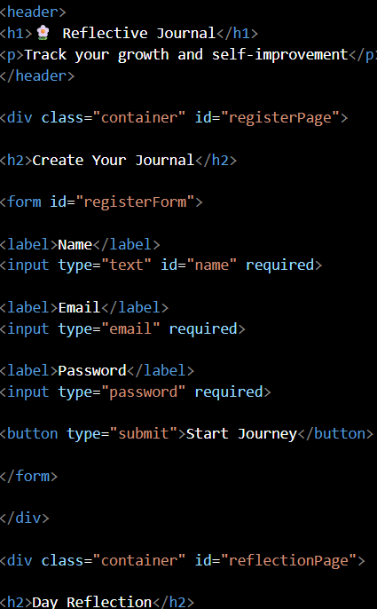
Screenshots for FWD & DSA

Slide 13
Conclusion
The journal web page provides a simple and organized platform for users to record their daily thoughts and reflections.
The system helps users express their feelings, understand their experiences, and think about personal improvement.
The structured writing process encourages users to reflect on their day, identify what they learned, and plan positive changes for the future.
The application creates a private and comfortable space for thoughtful writing and self-expression.
This project demonstrates how a digital journaling system can support self-awareness, emotional well-being, and personal growth.
Overall, the journal web page serves as a useful tool for maintaining daily reflections and developing better self-understanding.

Slide 14
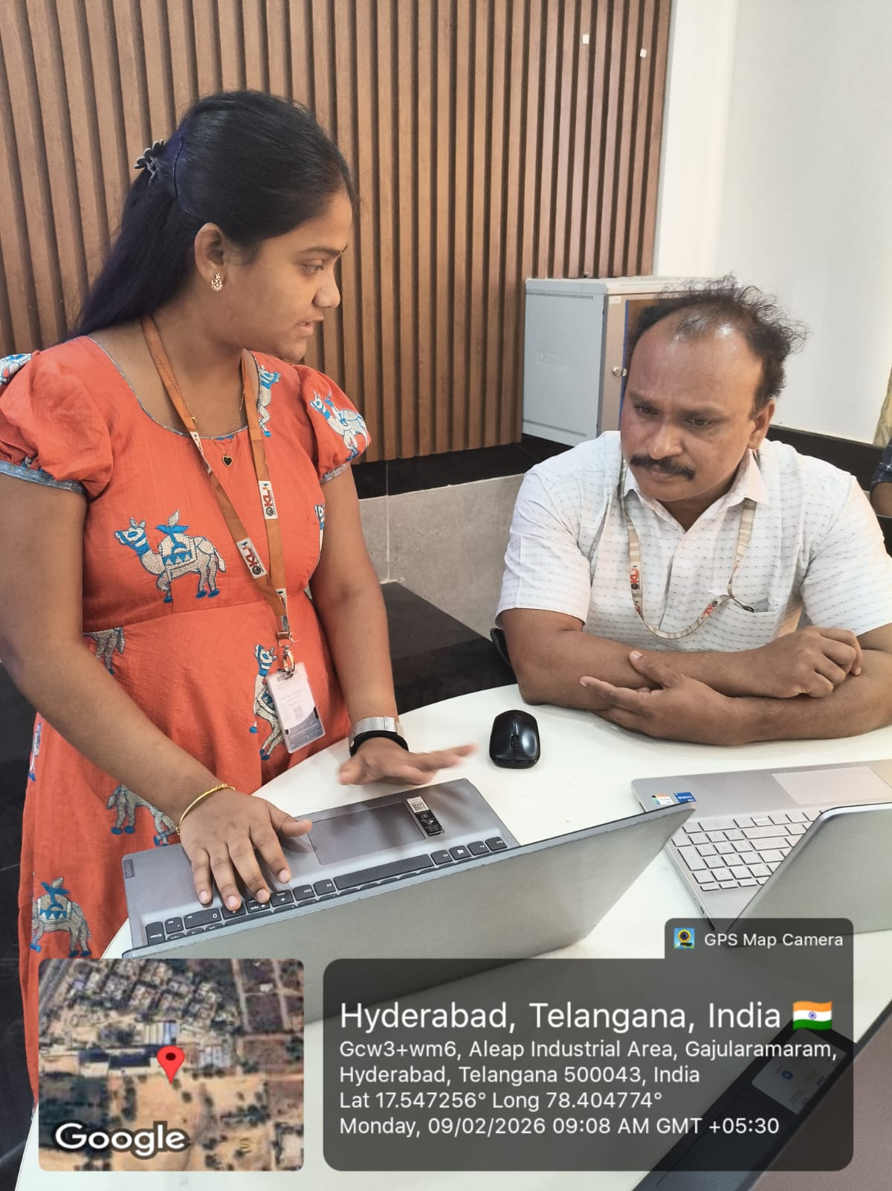
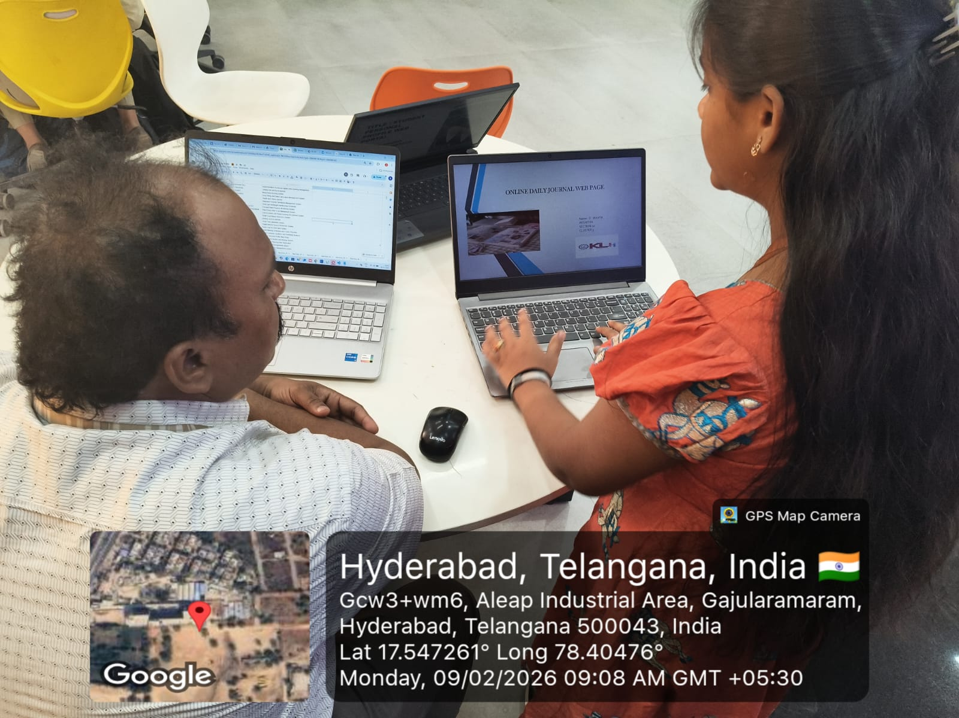
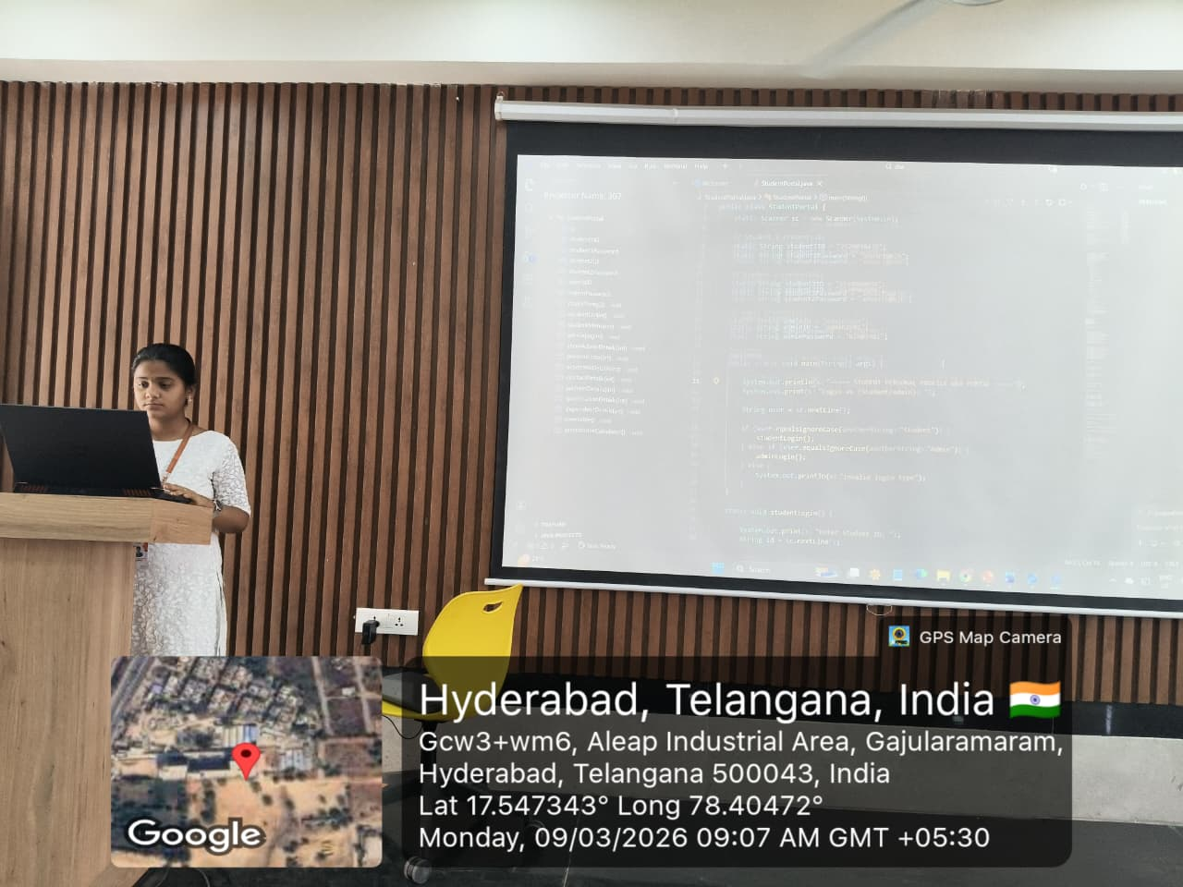
Geo- Tag Photos

Slide 15
THANK YOU

